Slide 1
COVID-19
Financial Statement Disclosures
Natural Language Processing
Jason Dunleavy, Data Scientist

Slide 2

Background

Slide 3


Background
Q1 2020: COVID-19
Business implications
Accounting implications
Additional required disclosures
SEC CF Disclosure Guidance: Topic No. 9A

Slide 4
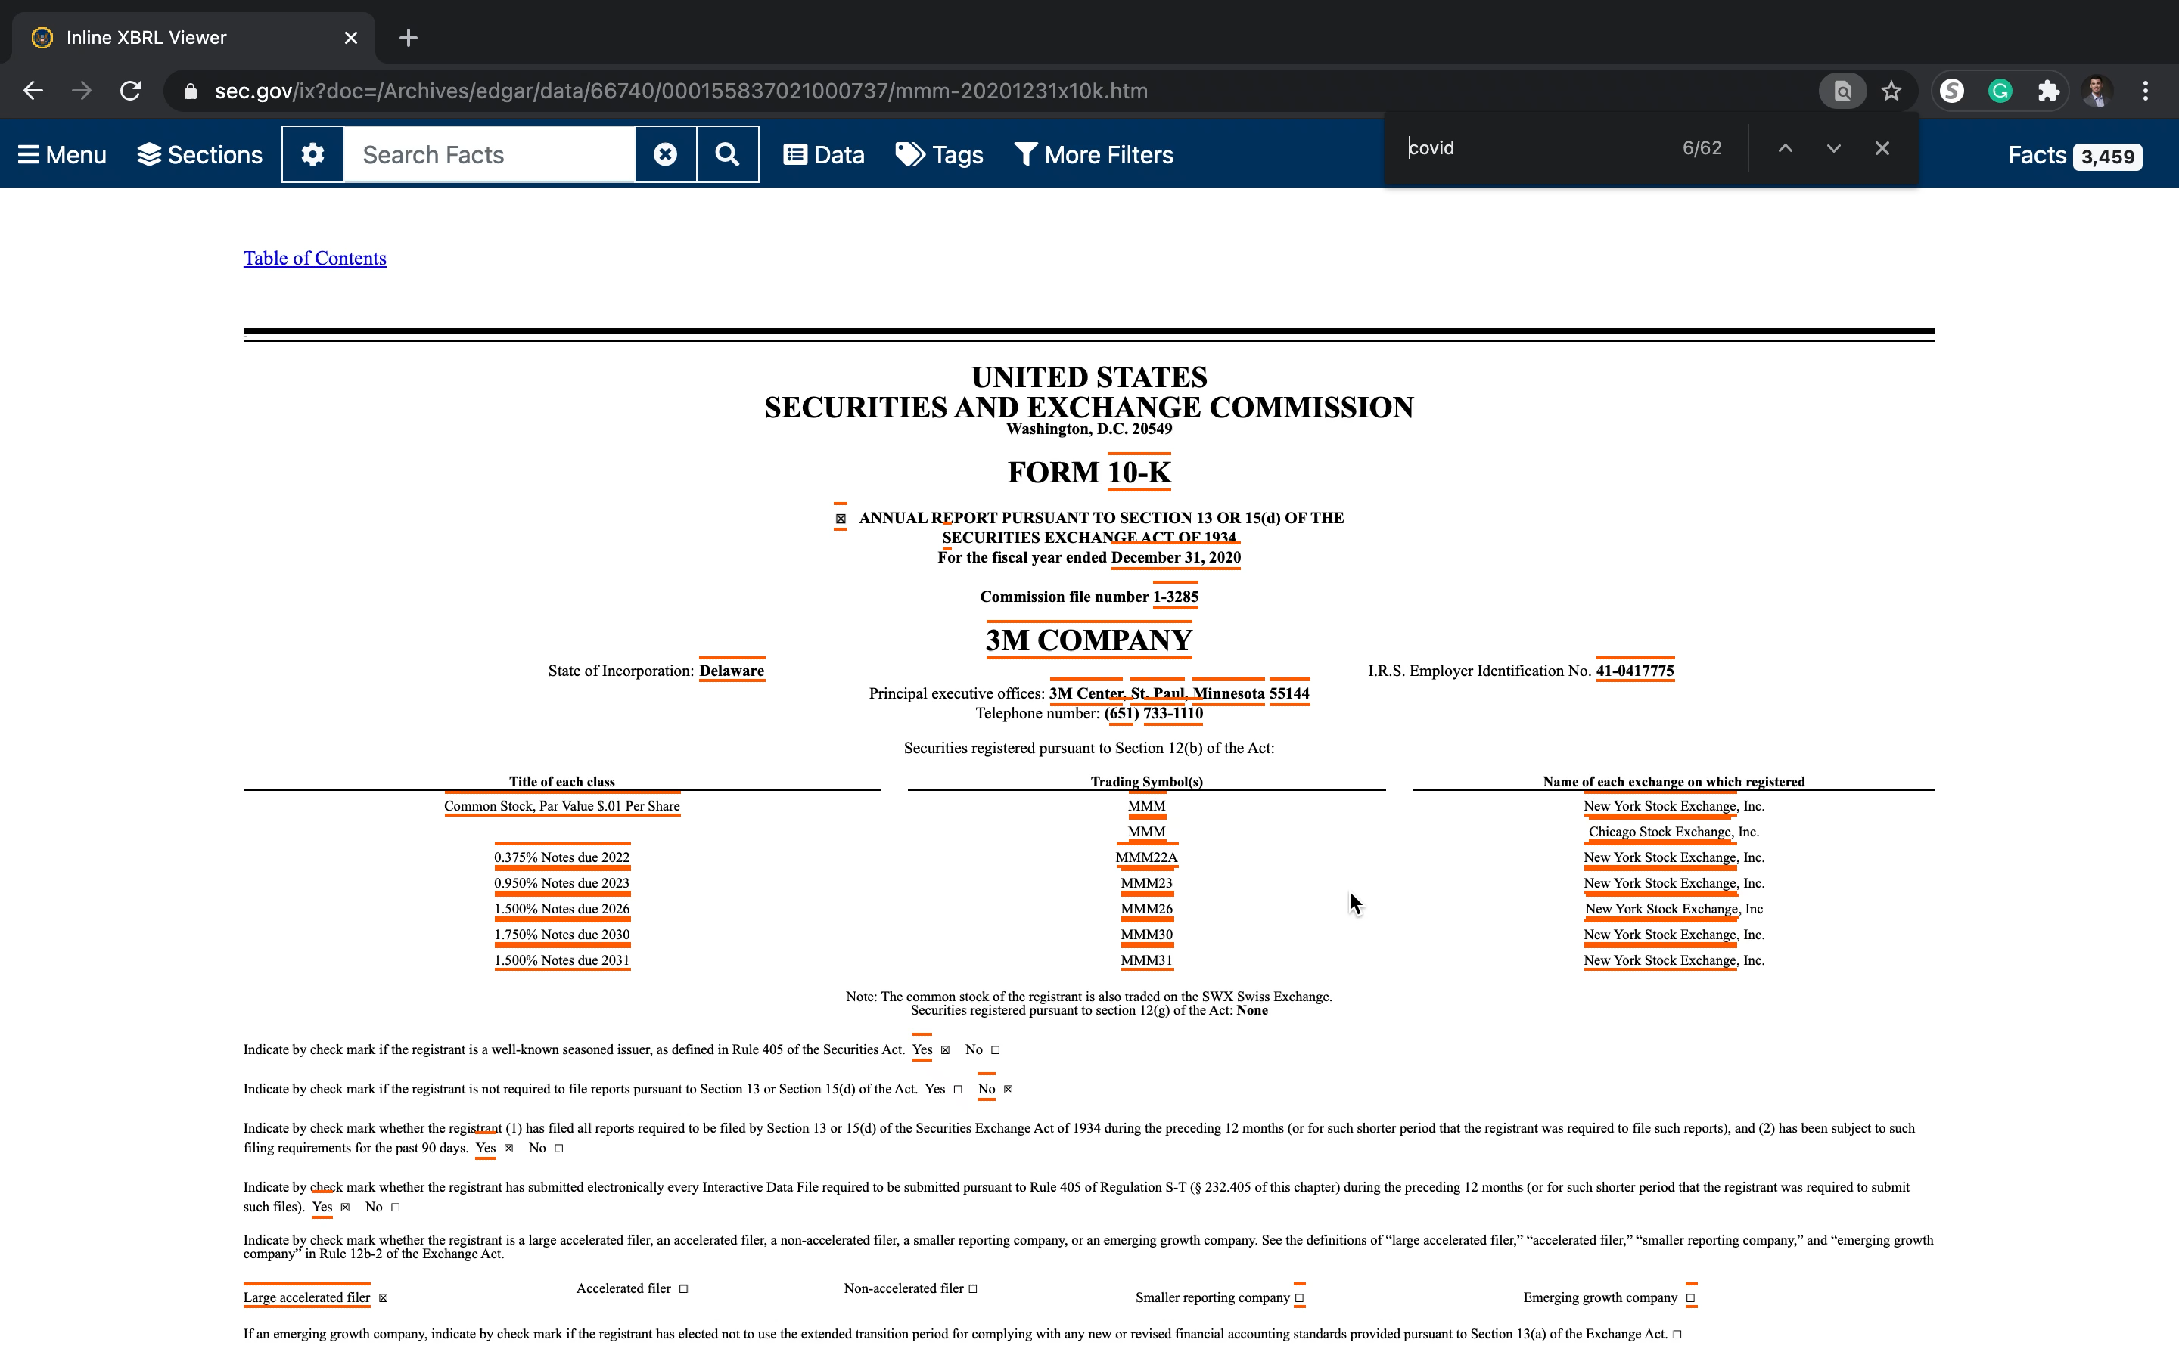
Motivation

Slide 5

Methodologies

Slide 6




Pipeline
Web Scraping
Text Preprocessing
Topic Modeling
Sentiment Analysis
SEC API
BeautifulSoup
Stop words
Bigrams/Trigrams
Number removal
TF-IDF
NMF
LDA
VADER

Slide 7

Findings

Slide 8

DASHBOARD
https://public.tableau.com/profile/jason.dunleavy#!/vizhome/covid_disclosures/COVID-19FinancialStatementDisclosures?publish=yes

Slide 9

Future Work

Slide 10
Future Work
- Train sentiment classifier on financial statement text
- Continue collecting data through end of pandemic
- Analyze financial news data
- Feed output of model into a classification problem

Slide 11

Q&A
Thank You

Slide 12

Appendix

Slide 13
Data Sources
S&P 500 Listing:
https://datahub.io/core/s-and-p-500-companies
Ticker to CIK Mapping:
https://www.sec.gov/include/ticker.txt
SEC API:
https://sec-api.io/
Financial Statement Filings (various):
https://www.sec.gov/edgar/searchedgar/companysearch.html

Slide 14






Tools & Packages

